Slide 1
Normal (“bump”) mapping
INFO-6020 “Graphics 2”

Slide 2
TLDR:
Instead of drawing all the tiny geometry we:
Save a lower resolution model
A texture that shows the difference between the normal of the high-resolution model and the low-resolution model
Making this texture is often called “baking”
Sort of like vertex displacements with height maps: low resolution model + tessellation + texture = high resolution model
Reduces the “polygon” or “triangle” count
Texture look-ups are vastly less expensive than rendering the high-resolution geometry and look indistinguishable

Slide 3
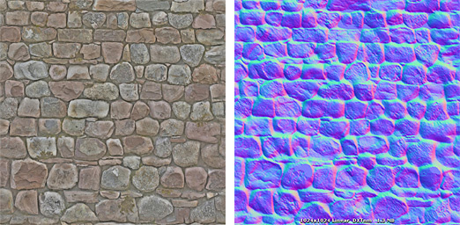
Normal/bump map texture
The normal map texture is stored in like a regular colour texture, but instead of colours, it stores the normal direction. Often we can just use an 8 bit RGB texture as we are just storing the slight differences in the surface normal (i.e. the 8 bit range is only -128 to 128, so 7 bits rather than a full floating point).
The “blue-ish” colour is because most of the normals point in generally in the z direction, 3rd value being blue.
Knowing this we can store it in a different format like GL_RGB10_A2 or GL_R11F_G11F_B10F or a compressed format

Slide 4
Normal/bump map texture
The normal map texture is stored in like a regular colour texture, but instead of colours, it stores the normal direction. Often we can just use an 8 bit RGB texture as we are just storing the slight differences in the surface normal (i.e. the 8 bit range is only -128 to 128, so 7 bits per axis rather than full 32bit floating point value).
The “blue-ish” colour is because most of the normals point in generally in the z direction, 3rd value being blue.
Knowing this we can store it in a different format like GL_RGB10_A2 or GL_R11F_G11F_B10F or a compressed format, but this is relatively rare.
Another option is one texture per axis, so 3 greyscale images. Again, pretty rare.
Also note that many of the UV values are stored with the Y (V) going the “other” way: 0 being the bottom, rather than OpenGL which starts at the top.

Slide 5
Range
Note that the values stored in the texture are only positive (0.0 to 1.0), whereas the actual normal values range from -1.0 to 1.0.
To adjust this, we alter the sampled values:
bumpNormalXYZ = (normalSampledXYZ * 2.0) – 1.0;
“* 2.0” scales the 0.0 to 1.0 value to 0.0 to 2.0
“- 0.1” shifts this down to -1.0 to 1.0

Slide 6
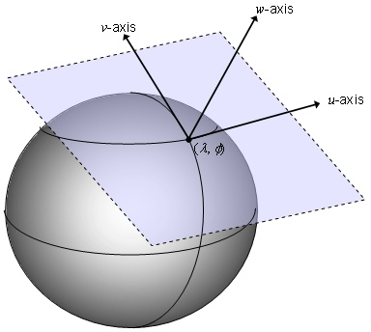
Tangent space
We have another issue as well.
With a flat surface, like this wall map, we can just assume/guess the overall direction of the normal.
Say the wall is along the x-axis with y being “up”, and it’s facing you, say along the +ve z axis.
In that case, the normal values read from the normal map face in the “correct” direction

Slide 7
Tangent space
But what if we rotate the wall?
Now the normal values are not facing along the +ve z axis.
We could just rotate the normal values from the normal map…
…but that wouldn’t work on models that are simple and flat.
Instead, we say that the normal are stored in “tangent” space

Slide 8
Tangent space
“Tangent space” refers to a plane that is at right angles to the normal, or at a “tangent” to the surface of the vertex.
With a flat surface, this tangent space is the same everywhere, but you can see this is the exception.
With this sphere, the tangent space would change continuously over the surface.

Slide 9
Tangent space
There’s another issue.
Imagine the plane in the picture is rotated around the normal (the “w-axis” in this image).
You could rotate it an infinite number of angles and it would still be “tangential” to the surface and at right angles to the normal.
This isn’t really useful…

Slide 10
Tangent space
So, a convention is to assume that this plane is aligned to the UV coordinates of the mesh.
The U being the “x” axis and the “V” being the “y” axis of this imaginary tangential plane.
This allows is to match the X, Y, and Z axis from the mesh’s normal with the X, Y, and Z axis in the normal map

Slide 11
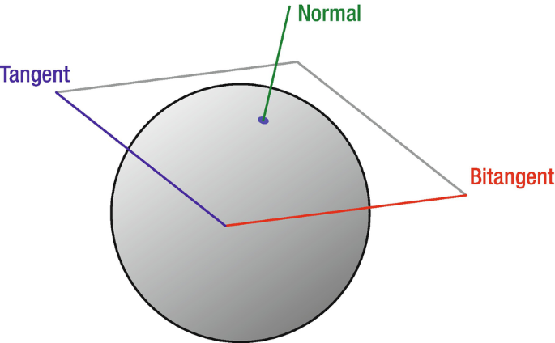
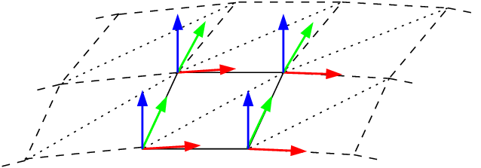
Normal, Bi-normal, and tangent
The “bi-normal” (or “bi-tangent”) is at right angles to both the normal and the tangent directions
Here’s two different images to help visualize this. Note the convention difference:
In the top, the “tangent” is along the Y/V axis
In the bottom, it’s not labelled, but the tangent could be the red (along the X/U axis)
This is the more common convention, so it’s what we’ll use

Slide 12
Normal, Bi-normal, and tangent
We are also going to assume that the normal is along the z axis.
(remember the normal map that’s “blue-ish” colour because the general direction of the normal is along the z axis?)
This means these three directions:
Normal: 0, 0, 1.0 (+ve along z)
Tangent: 1.0, 0, 0 (+ve along x)
Bi-tangent: 0, 1.0, 0 (+ve along y)

Slide 13
Normal, Bi-normal, and tangent
To figure out where the adjusted normal is, we have to transform this normal map values into tangent space, make adjustments, then transform back.
We do this with a “Tangent, Bi-normal, Normal” matrix, or TBN matrix.
Also, remember we had to rotate the normal of the surface with the model matrix? We have to do this with the tangent and bi-normal, too.

Slide 14
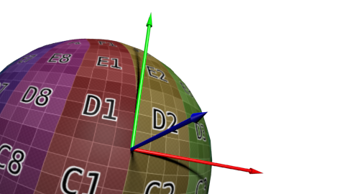
Generating the tangent/bi-normal
In this image, the normal is the blue arrow
The red is the “tangent” arrow (or you could use the green)
Note that these green and red arrows follow the direction of the textures that are applied.
Conventionally, the tangent goes “positive” along the U texture coordinate and the bi-tangent/bi-normal goes “positive” along the V texture coordinate.
We can assume that the texture coordinates are present as we’ll need them to do the normal map lookup, right?

Slide 15
Generating the tangent/bi-normal
We can manually calculate this… (see: https://learnopengl.com/Advanced-Lighting/Normal-Mapping or https://www.opengl-tutorial.org/intermediate-tutorials/tutorial-13-normal-mapping/, etc.)
Or we can use assimp or blender (or whatever tool) to calculate this for us (sort of like the normal calculation)
aiProcess_CalcTangentSpace ← Generates tangent and bi-tangent/bi-normal
aiProcess_Triangulate ← Generally a good idea (models often quads/n-gons)
aiProcess_FlipUVs ← For OpenGL (v/t axis starts at top in OpenGL)

Slide 16
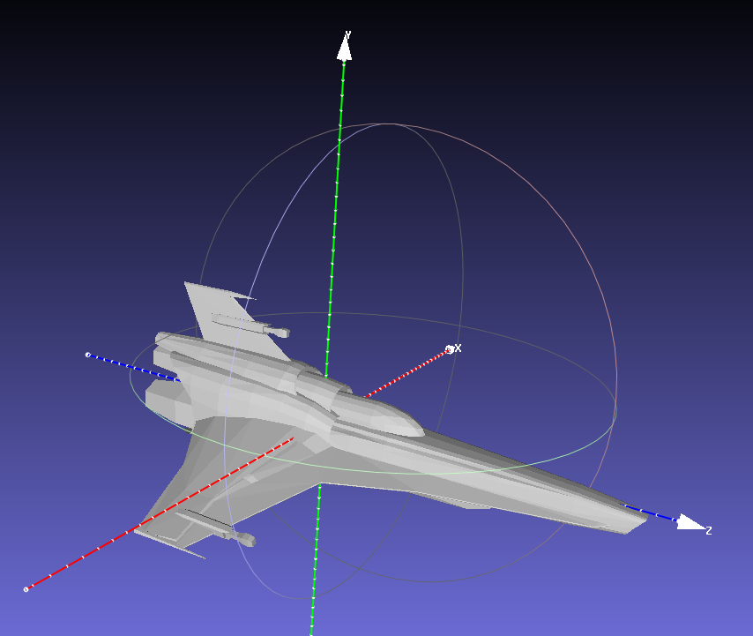
“Tangent space”
We often talk of different “spaces”:
Model space
World space
Screen space
Camera space
You can think of this as “where’s the origin?” and “what direction is up?”, etc.
For example: This Viper model has the +ve Z axis “forward”, the +ve Y axis as “up” (and the +vs X axis as “to the left).
Also, the “origin” is somewhere in the middle of the model

Slide 17
“Tangent space”
HOWEVER, this is only according to the model, like if you were sitting inside the ship, the front of the ship would always be pointing “forward” according to you.
This is like when you’re driving in your car going “forward” along the road… but this is independent of the actual map direction you are going: like North, South-East, whatever.
You are going “forward” or “turning left” or whatever…
…but your car is going “36 degrees South-West” in the world.
It’s the same when we transform the model in the computer:
The locations on the model are “transformed” into “world space”

Slide 18
“Tangent space”
More technically:
The “model” (or “world”) matrix transforms the locations of the model into “world space” (They are placed “in the world”)
The “view” (or camera) matrix transforms them into “camera” (or “eye”) space – where they are relative to the camera
The “projection” matrix transforms that to where those positions are on the screen, so “screen space”
We have to do the same sort of thing to make any sense of the normal maps because they are in “tangent” space, which is specific to each vertex.

Slide 19
“Tangent space”
Normal maps are also flat.
Imagine this spere (top-right) was flattened out to a plane…
In that case, all the normal would face the same way: up
In fact, any mesh that’s been flattened to a plane would do this.
Because the normal are, by definition, perpendicular to the surface.
We need to calculate the transformation (matrix) that takes any model mesh of any shape into a flat plane.
Yikes.
Yeah, yikes. That sounds almost impossible, right?
Luckily the math nerds have come to our rescue (again)!

Slide 20
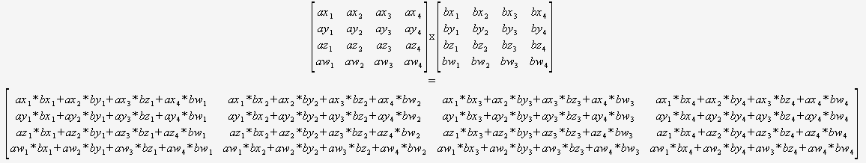
“Tangent space”
Remember, long ago in ancient times, when matrix math was new and strange and terrifying?
Yeah, well it still is all of those things (😱😭) - we are just used to it!
You also remember thinking: how did someone come up with all of this crazy stuff?? How can I understand it??

Slide 21
“Tangent space”
You also remember thinking: how did someone come up with all of this crazy stuff?? How can I understand it??
Both excellent questions.
But this isn’t a “math” program, right?
We just have to trust the process…

Slide 22
“Tangent space”
Some resources about “tangent space”):
https://en.wikipedia.org/wiki/Tangent_space
https://www.cis.upenn.edu/~cis6100/cis61005sl7.pdf
https://math.mit.edu/classes/18.101/fa07/pub/manifolds-3.pdf
https://www.math.utoronto.ca/mgualt/courses/18-367/docs/DiffGeomNotes-8.pdf
OpenGL SuperBible book, “normal mapping”
https://learnopengl.com/Advanced-Lighting/Normal-Mapping
https://io7m.github.io/r2/documentation/p2s23.xhtml (very good)

Slide 23
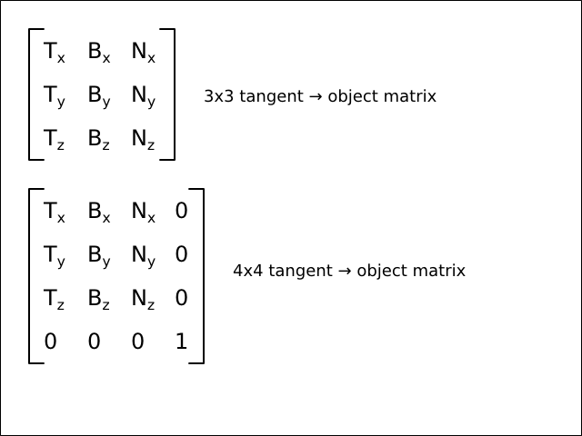
“Tangent space”
Basically “because math” we can transform any point on the surface of a mesh (in object/world space) into that plane where the normal/bump map is (“tangent space”) using a “Tangent-BiTangent-Normal” (or TBN) matrix.
Each column of the matrix is represented by the Tangent, Bi-Tangent, and Normal:
From: https://io7m.github.io/r2/documentation/p2s23.xhtml

Slide 24
“Tangent space”
The values we place in there are the Tangent, Bi-Normal, and Normal at each vertex.
vec3 T = normalize(matModel * vTangent);
vec3 B = normalize(matModel * vBitangent);
vec3 N = normalize(matModel * vNormal);
mat3 TBN = mat3(T, B, N);
Note: here the matModel is a 3x3, so just the rotation part of the matrix.
You can get this by using the inverse-transpose of the model matrix
From: https://io7m.github.io/r2/documentation/p2s23.xhtml

Slide 25
“Tangent space”
Two ways to use this:
Transform the vertex values into tangent space, then do all the lighting there. This means we have to ALSO transform all the other things from world space to tangent space, too: camera (eye), lighting, etc.
Advantage: we only do the transformation in the vertex shader (faster) and use the interpolation part (between the vertex and fragment shader) to “fill in” the rest (which it’s doing anyway, right?)
Disadvantage: All the lighting (and everything else) is in tangent space instead of world (or screen) space, so it’s way more confusing.
Transform the normal map values into world space
Advantage: Everything is likely already in world space in the shader, so easier to understand.
Disadvantage: We are doing this matrix transformation for every vertex on the surface individually, so it’s more expensive.

Slide 26
“Tangent space”
Two ways to use this:
Transform the vertex values into tangent space, then do all the lighting there. This means we have to ALSO transform all the other things from world space to tangent space, too: camera (eye), lighting, etc.
Advantage: we only do the transformation in the vertex shader (faster) and use the interpolation part (between the vertex and fragment shader) to “fill in” the rest (which it’s doing anyway, right?)
Disadvantage: All the lighting (and everything else) is in tangent space instead of world (or screen) space, so it’s way more confusing.
Transform the normal map values into world space
Advantage: Everything is likely already in world space in the shader, so easier to understand.
Disadvantage: We are doing this matrix transformation for every vertex on the surface individually, so it’s more expensive.
We’re going to do it the 2nd way.

Slide 27
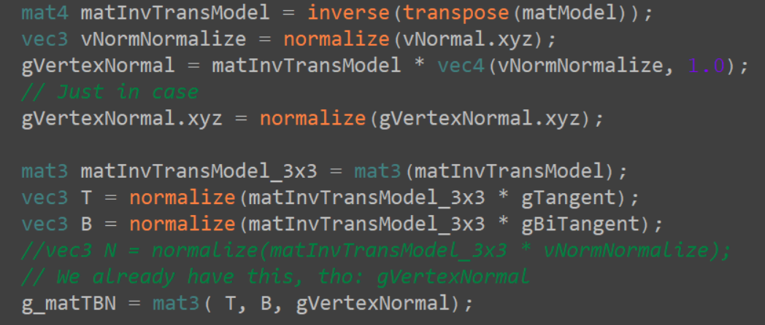
In the vertex shader
We calculate the TBN matrix in the vertex shader:

Slide 28
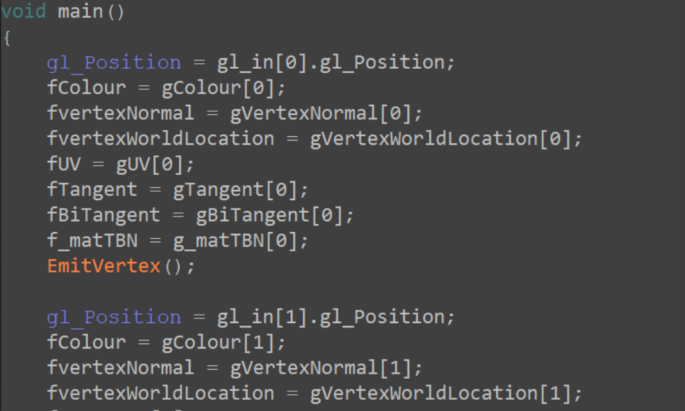
(in the geometry shader…)
Our code has a geometry shader, so we have to handle that, too
(This is just a pass-through, unless we’re doing something else…)
We’d to this for vertex #1 and #2 as well…

Slide 29
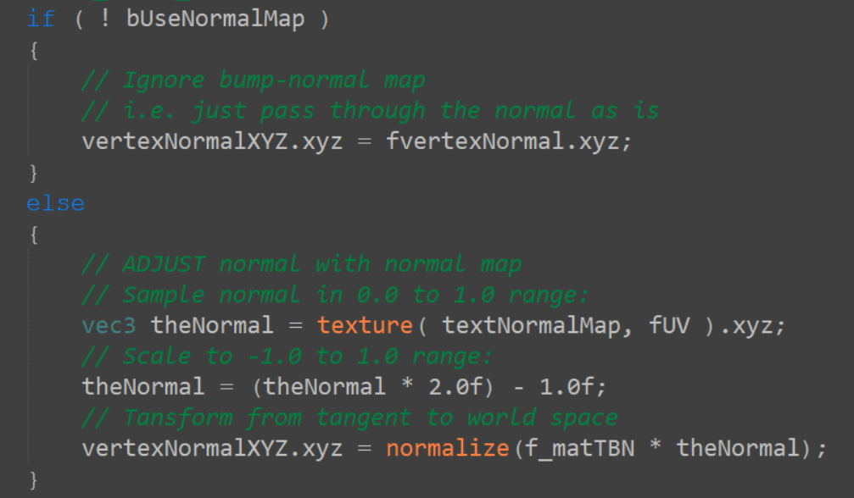
In the fragment shader
Now we do the “bumping”, adjusting the vertex normal with the normal/bump map sample:

